Slide 1


Security Token 2.0
Index
New Features
Architecture
Administrable
Partitions
Modular Constraints
Free Transactions
Security Token 2.0
13.03.2018 | Merck Finck Privatbankiers

Slide 2

Company Overview
Offices Germany
Corporate Structure
Office Essen
Kruppstraße 82 - 100
Germany-45145 Essen
Office Düsseldorf
Königsallee 61
Germany-40125 Düsseldorf
Software development
Tokenization Platform
Office Frankfurt
Taunusanlage 8
Germany-60329 Frankfurt am Main
Office Asia
Partner (selection)
Singapore
5F Republic Plaza, 9 Raffles Place Singapore, 048619
Confidential information

Slide 3







micobo GmbH
References (selection) and Management
Banking / FinTech
DLT / Blockchain
Asset Tokenization
Christoph Impekoven
micobo GmbH
Email: ci@micobo.com
Tel.: +49 211 42471220
Mobile: +49 157 79336237
Christian Labetzsch
micobo GmbH
Email: cl@micobo.com
Tel.: +49 211 42471220
Mobile: +49 163 1755903
Confidential information

Slide 4

micobo Tokenpad
Enterprise Tokenization Solution
Features
ERC1400 & ERC20 compatibility
Modular constraints
Whitelist
Locking periods / partition
Spending limits / time / partition
Off-chain validation
Free transactions for token holders (GSN)
Controller operations
Document management
Confidential information

Slide 5
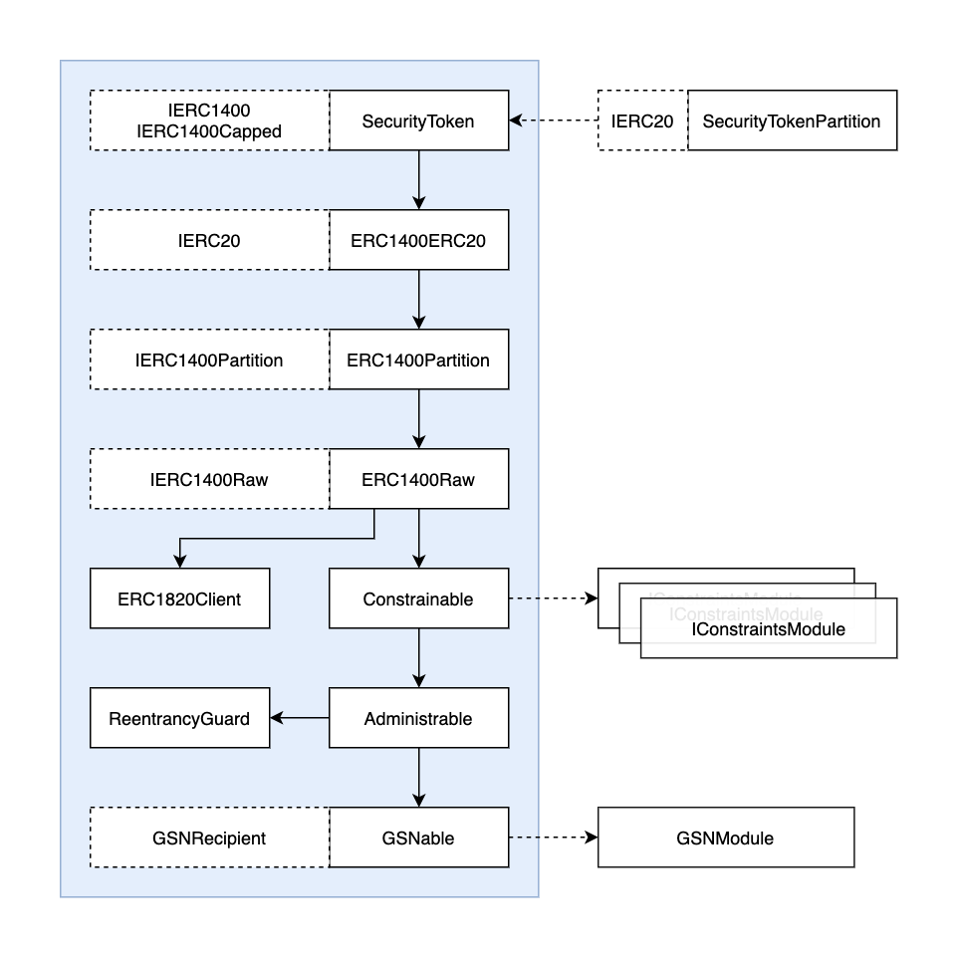
Architecture
Industry standard interfaces
Configurable GSN module
Confidential information

Slide 6
micobo Tokenpad
Enterprise Tokenization Solution
Administrable – Roles Management
Role | Description
ADMIN | Manage roles / add partitions
CONTROLLER | Force token transfer
ISSUER | Mint tokens
PAUSER | Pause transactions
REDEEMER | Burn tokens
CAP_EDITOR | Edit caps for partitions
MODULE_EDITOR | Edit constraints modules
DOCUMENT_EDITOR | Edit documents
WHITELIST_EDITOR | Edit whitelist
TIME_LOCK_EDITOR | Edit time-lock module
SPENDING_LIMITS_EDITOR | Edit spending-limits module
VESTING_PERIOD_EDITOR | Edit vesting-period module
GSN_CONTROLLER | Edit GSN behavior (allow, disallow, configure module)
DEFAULT_PARTITIONS_EDITOR | Edit default partitions to be used for ERC20 retro-compatibility
Confidential information

Slide 7
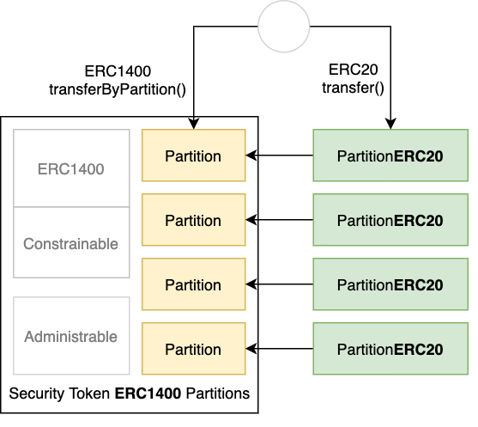
micobo Tokenpad
Enterprise Tokenization Solution
Partitions – ERC 1400 & ERC 20
Partitions can optionally be controlled by an ERC20 proxy contract. This allows representing each partition as an ERC20 if needed.
Confidential information

Slide 8
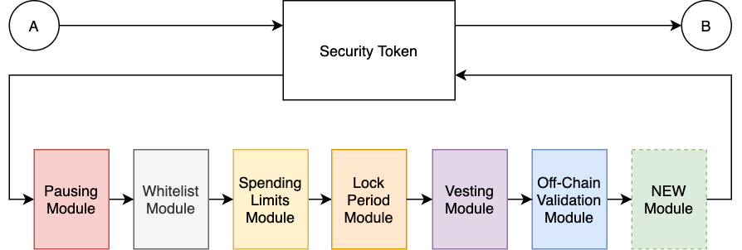
micobo Tokenpad
Enterprise Tokenization Solution
Modular Constraints –
Whitelist, Spending limits, lock periods, off-chain validation
You can set different constraints for your token. You can also invent new constraint modules!
Confidential information

Slide 9
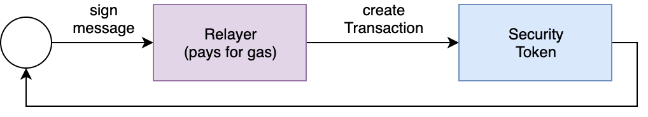
micobo Tokenpad
Enterprise Tokenization Solution
Free transactions
- Gas Station Network – Meta Transactions
You can allow free transactions for your token holders. You can set arbitrary rules for gas reimbursement!
Confidential information

Slide 10

Email: FinTech@micobo.com
Phone: +49 211 4247 1220
Office Frankfurt
Taunusanlage 8
60329 Frankfurt am Main
Office Essen
Kruppstr. 82 - 100
45145 Essen
Office Düsseldorf
Königsallee 61
40125 Düsseldorf
Office Singapore
5F Republic Plaza, 9 Raffles Place Singapore, 048619
micobo.com

